Slide 1
UFC Fight Prediction Model
Cade Kalander, Charles Lash, Joey Riley, Kohle Simmons

Slide 2

Can UFC Fights Be Predicted?

Slide 3
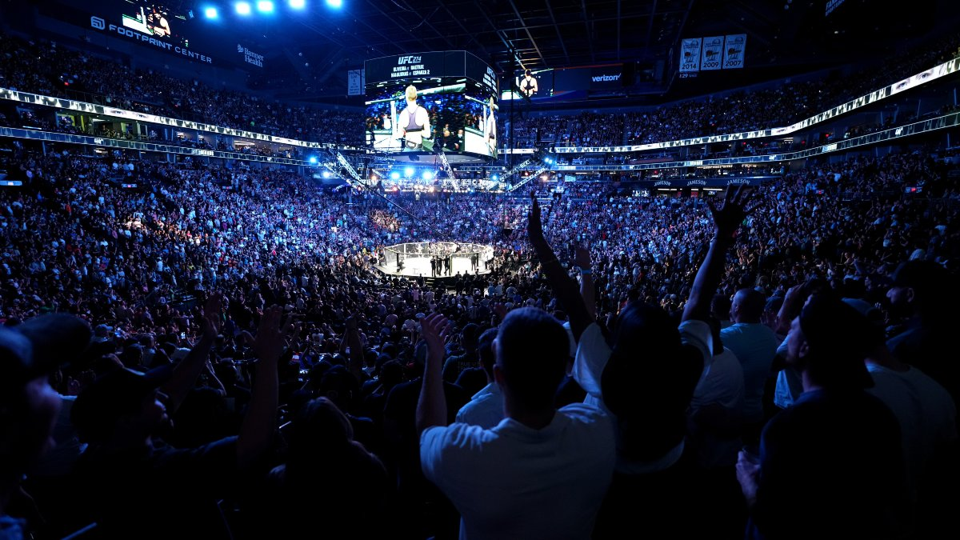
Why The UFC?
We Are Fans Of The Sport
Can An MMA Fight Be Predicted?
What Factors Are Correlated To Winning?

Slide 4
Source Data
The data we gathered came from kaggle.com, including statistics from the fighters: previous fights, physical build, age, location, and training camps.
https://www.kaggle.com/datasets/binduvr/pro-mma-fighters
https://www.kaggle.com/datasets/rajeevw/ufcdata

Slide 5
Focus Questions
What Is The Peak Age For A Fighter?
How Much Damage is Too Much?
Does A Specific Martial Art Reign Supreme?
Where In The World Are The Best Fighters?
Which Fight Camps Produces The Best Fighters?

Slide 6
Data Exploration

Slide 7
Data Analysis

